Slide 1
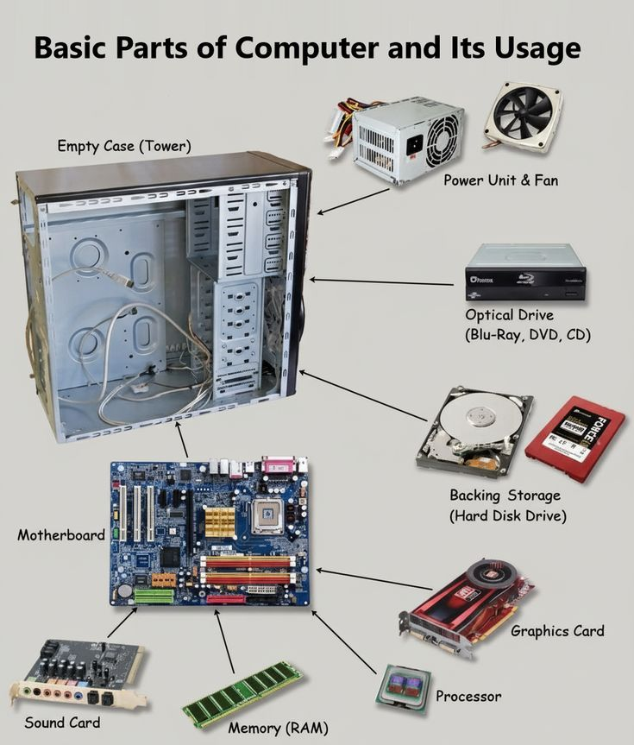
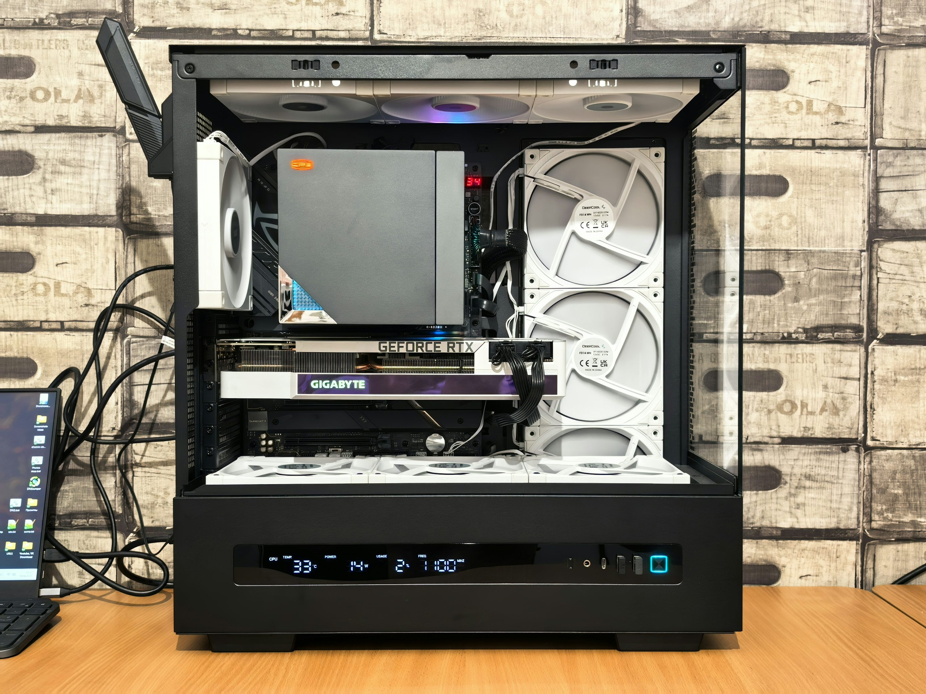
Inside the Computer
Blah blah

Slide 2
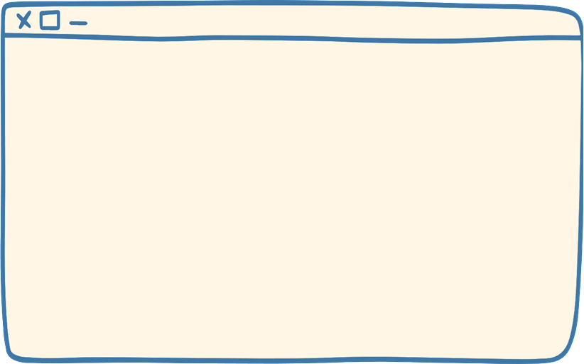
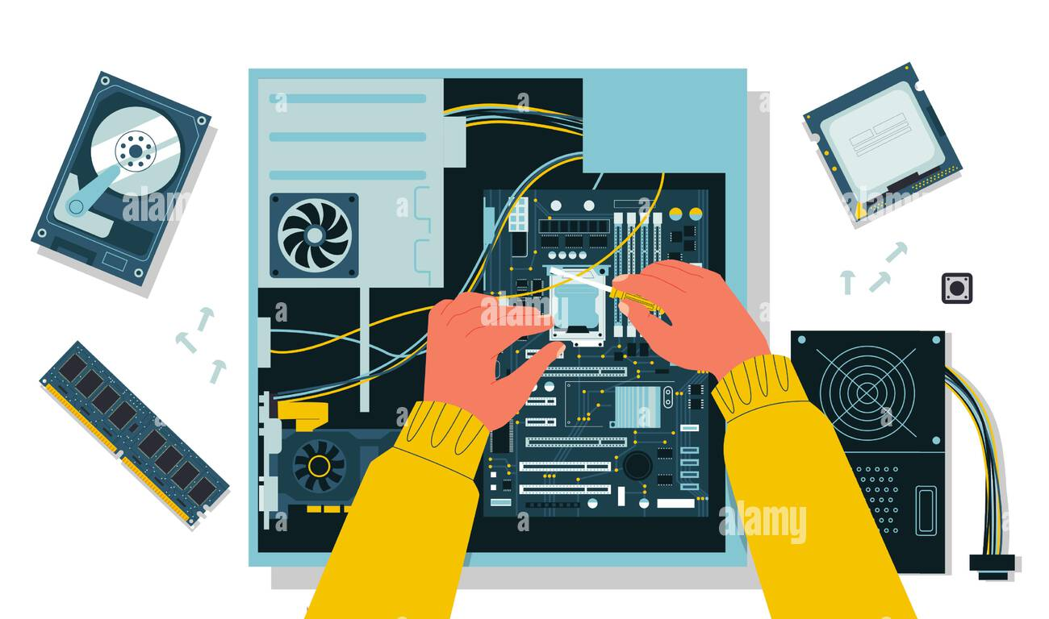
Why Understanding Hardware Matters
Blah blah

Slide 3
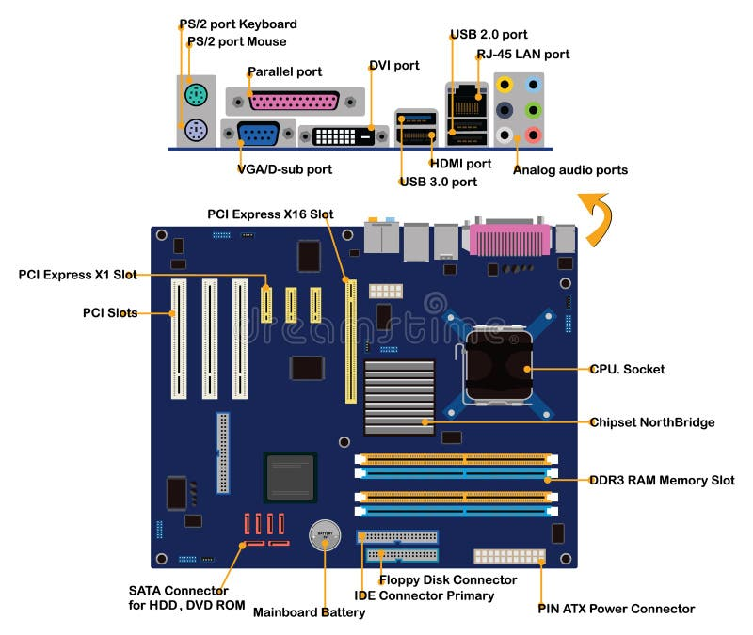
The Motherboard: The Great Backbone
Blah blah

Slide 4
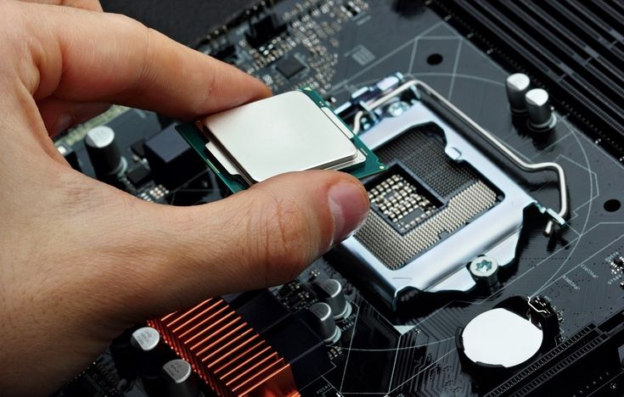
The CPU: The Brain of the Computer
Blah blah

Slide 5
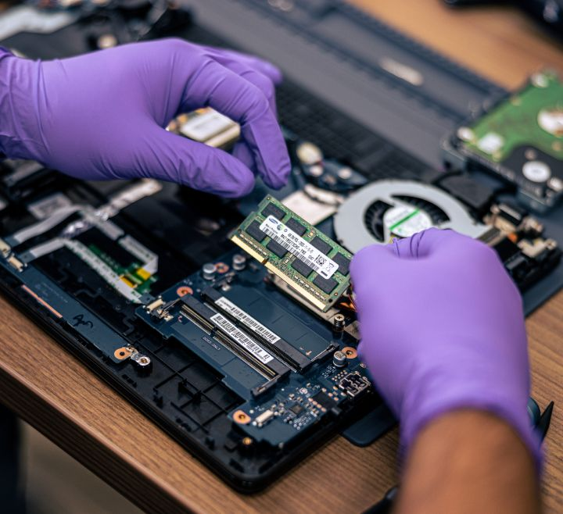
RAM: Your Quick, Short-Term Memory
Blah blah

Slide 6
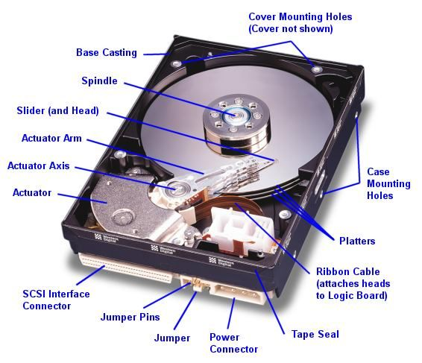
The Hard Drive: Permanent Storage
Blah blah

Slide 7
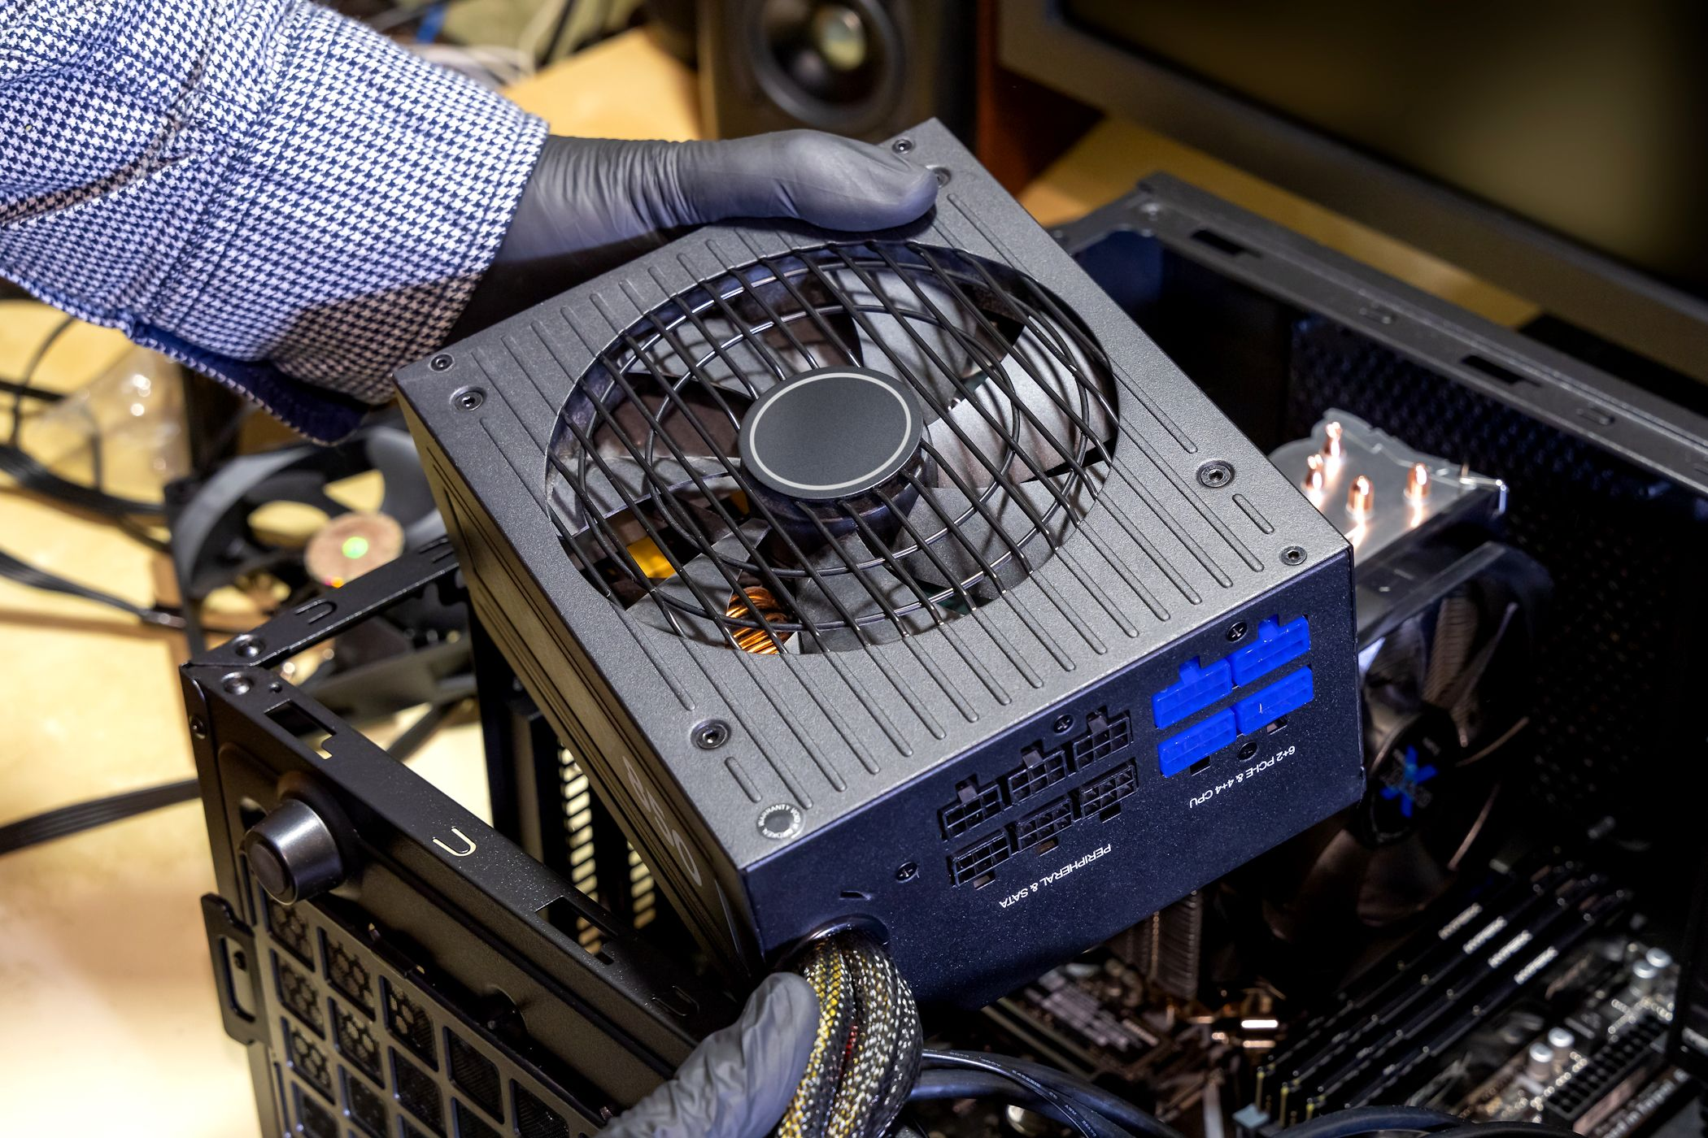
The Power Supply: The Electrical Source
Blah blah

Slide 8
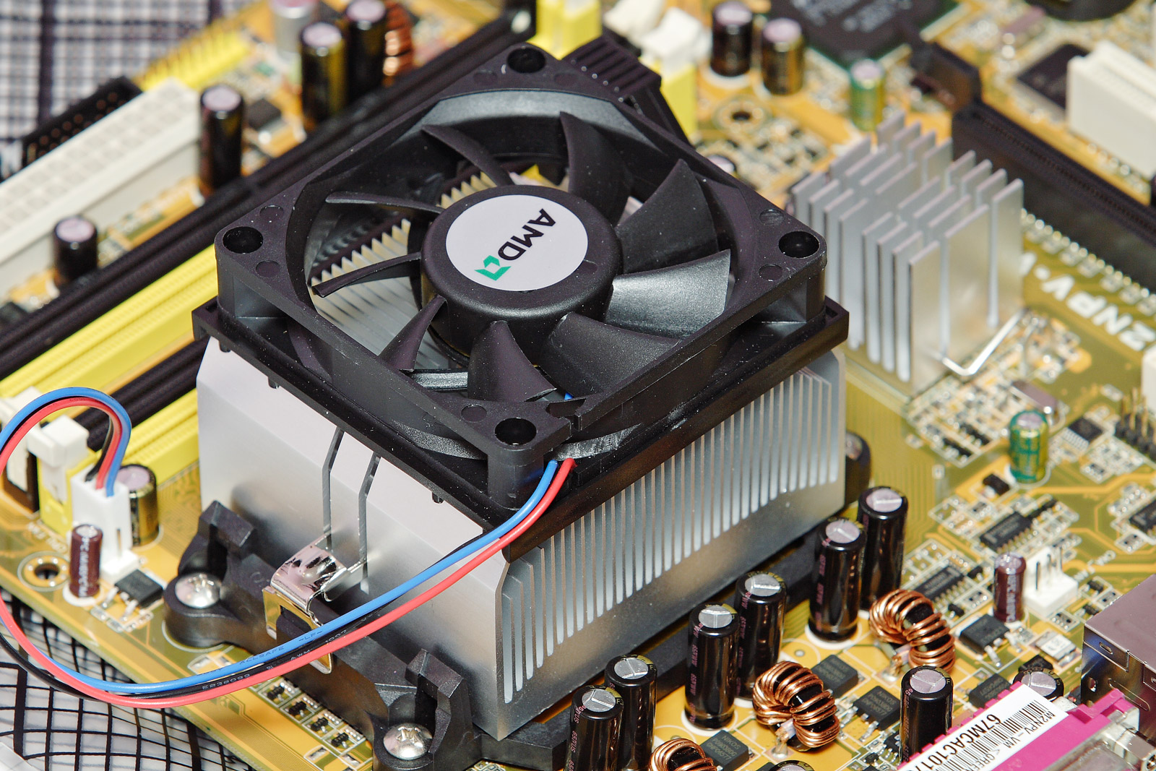
The Cooling System: Keeping it Cool
Blah blah

Slide 9
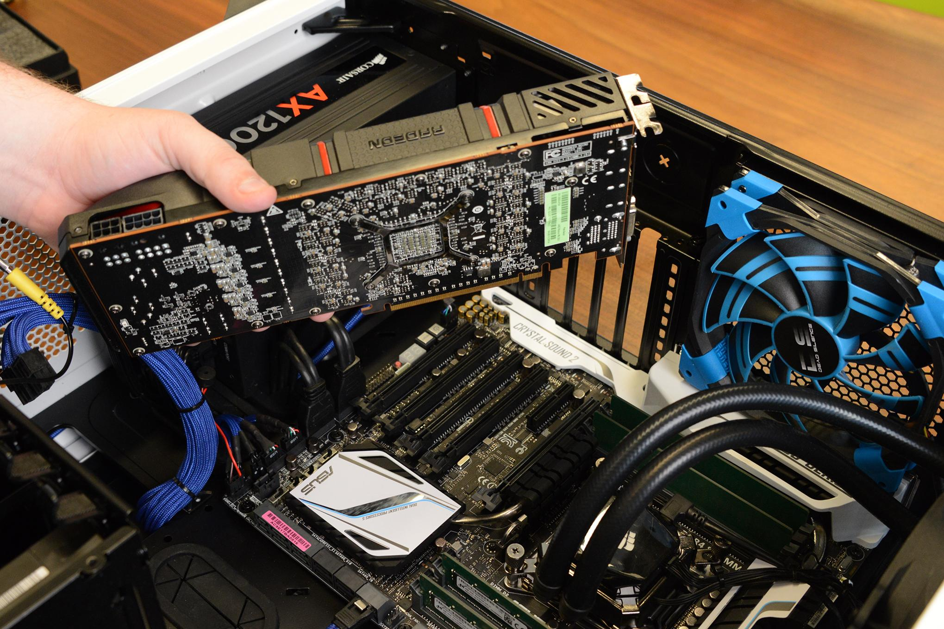
Expansion Cards: Upgrading Functions
Blah blah

Slide 10
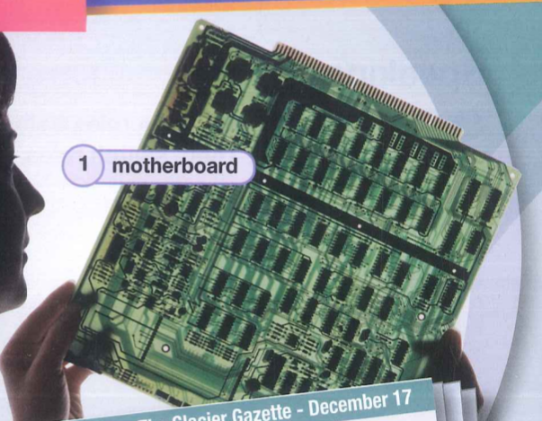
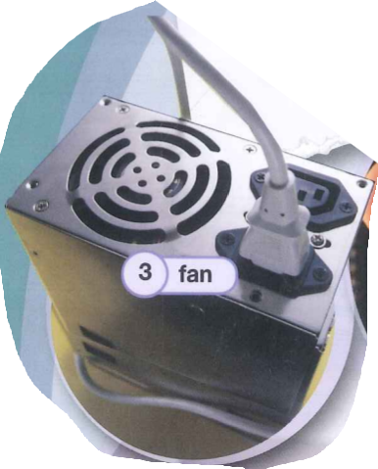
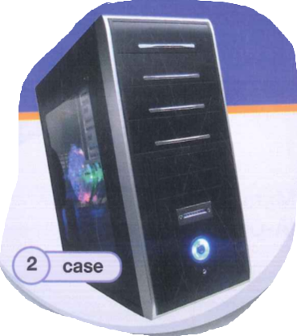
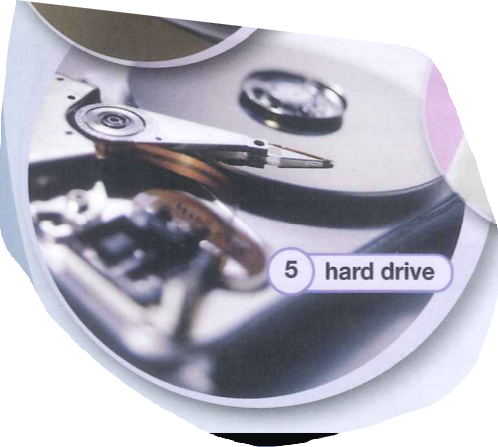
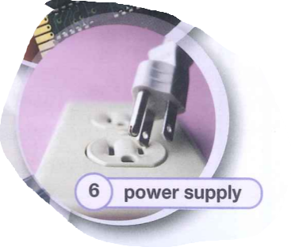
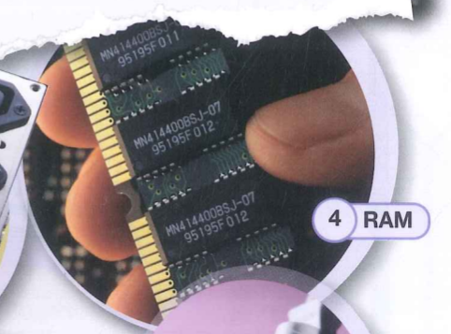
Step-by-Step Computer Assembly
Blah blah

Slide 11
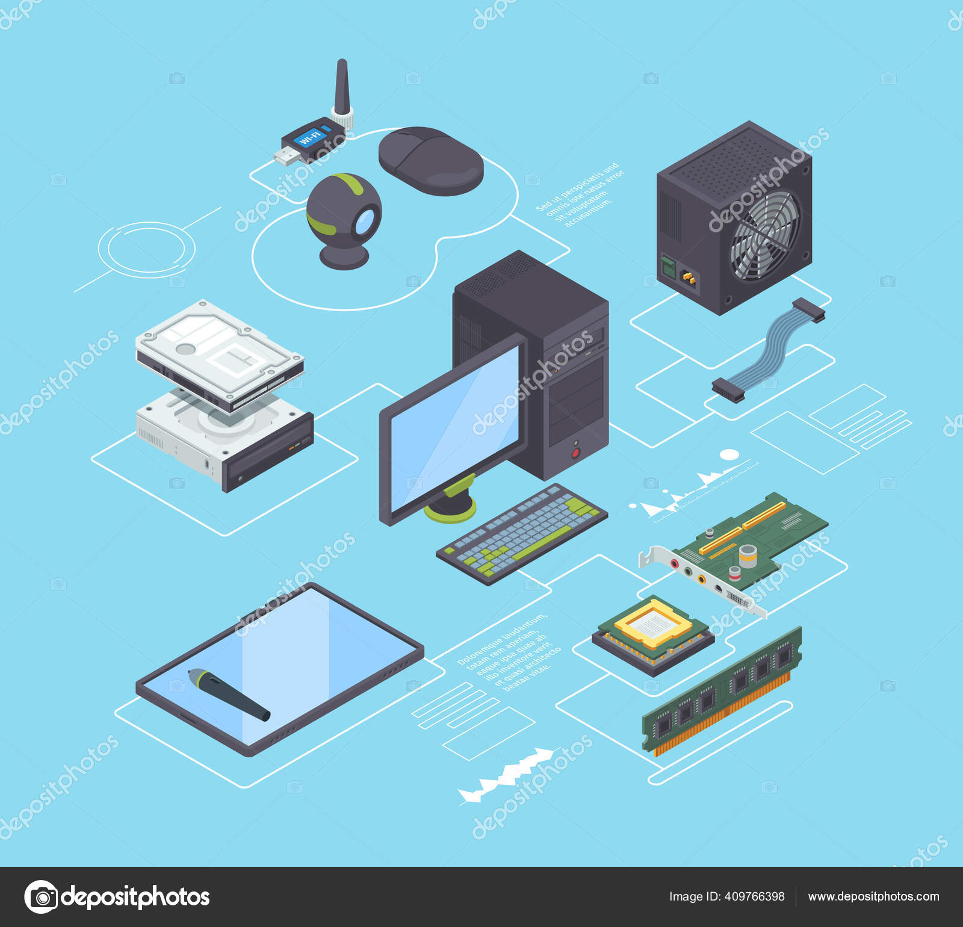
Summary: The Perfect Harmony
Blah blah

Slide 12


I’m the brain of your computer, thinking faster than a squirrel after coffee. What am I?
Question 1

Slide 13




CPU.
Function
It acts as the brain, processing all instructions so your computer can work.
CENTRAL PROCESSING UNIT.
Answer

Slide 14
I’m always at your right hand, clicking away… unless you’re a lefty! What computer part am I?
Question 2

Slide 15
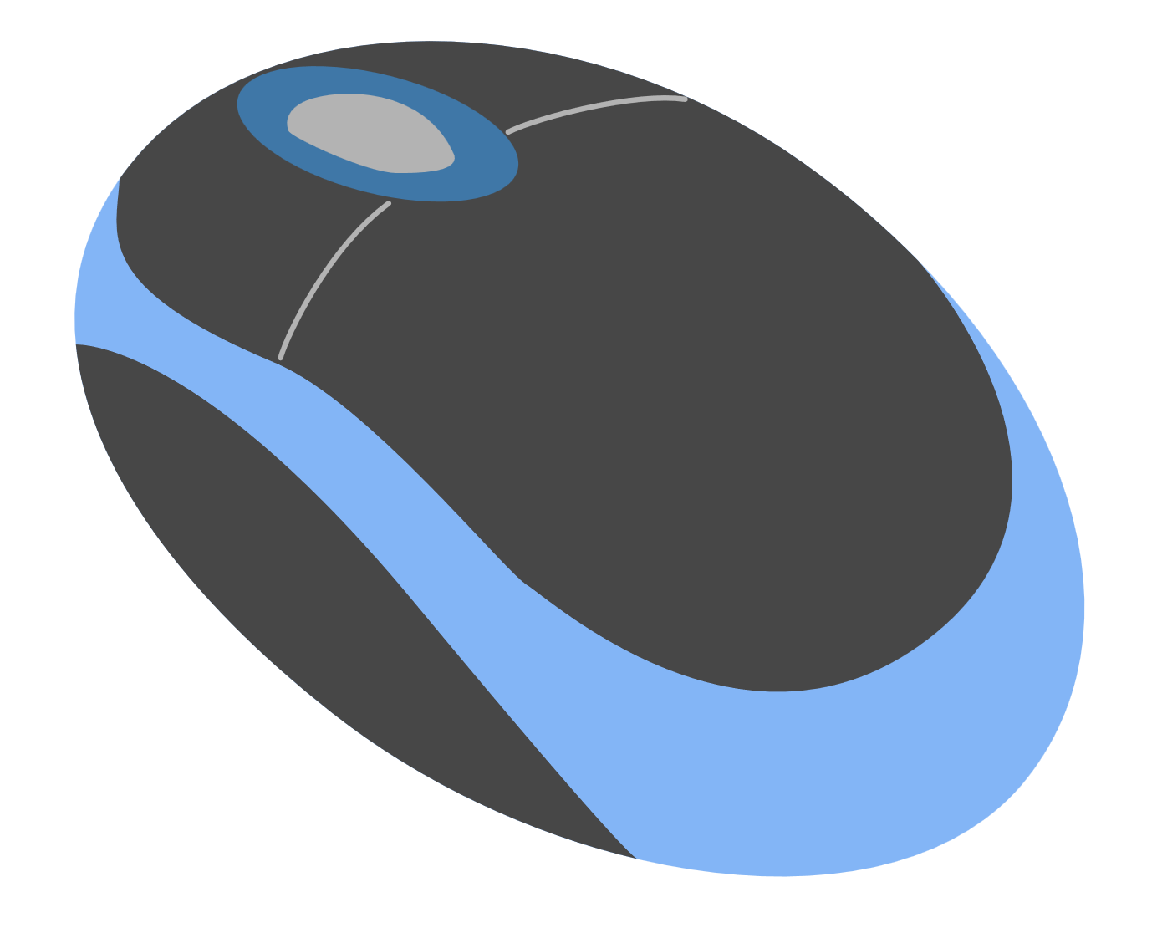
Function
MOUSE.
It lets you point, click, and move around your computer easily.
Answer

Slide 16
I store your memories but never forget… even when you do.
What’s my name?
Question 3

Slide 17

HARD
DRIVE.
Function
It saves all your files, photos, and programs for long-term use.
Answer

Slide 18
I’ve got keys but no doors, and I’m always ready for a good press. Who am I?
Question 4

Slide 19
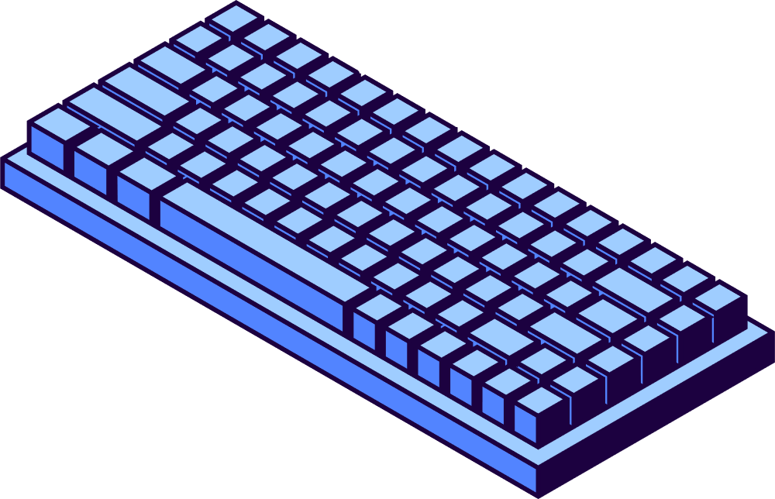
KEY
BOARD.
Function
It lets you type letters, numbers, and commands into your computer.
Answer

Slide 20
I take digital dreams and print them on paper.
What’s my name?
Question 5

Slide 21
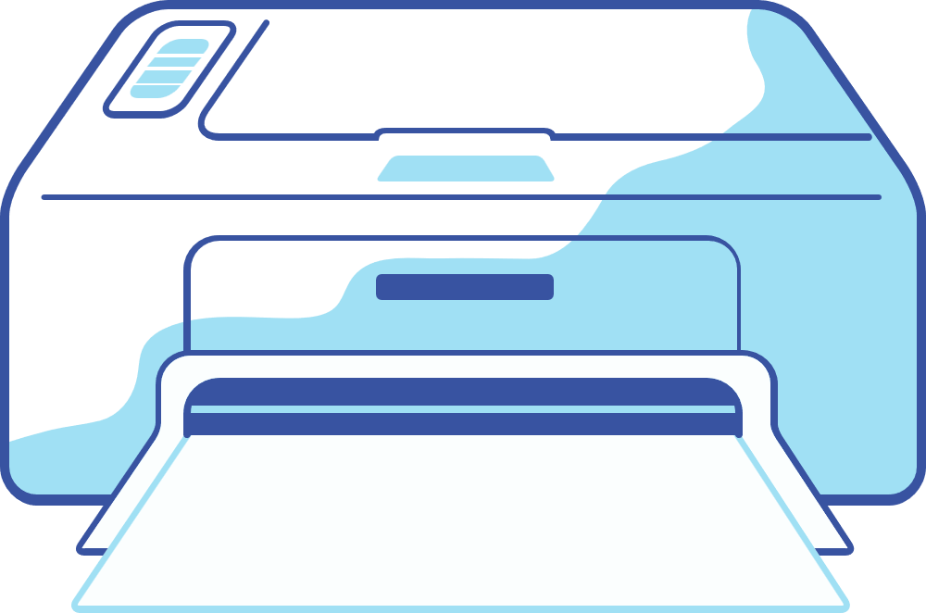
Function
PRINTER.
It turns your digital documents and pictures into real paper copies.
Answer

Slide 22
Without me, your computer naps forever.
I bring the energy!
Who am I?
Question 6

Slide 23

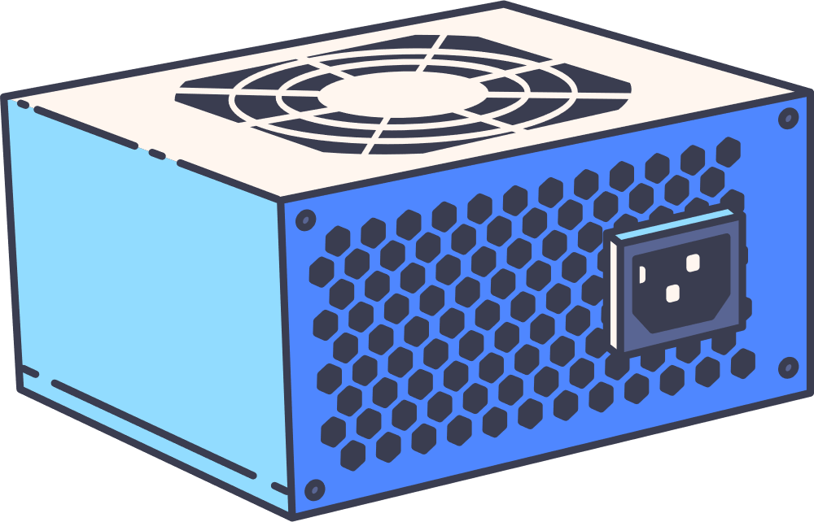
POWER SUPPLY.
Function
It gives power to every part of your computer so it can run.
Answer

Slide 24
THE END.
Thank you for your listening.

